Slide 1

Chapter 9: Savings, Interest Rates & the Market for Loanable Funds
Wayne Geerling
(University of Texas)

Slide 2
Big Questions
1. What is the loanable funds market?
2. What factors shift the supply of loanable funds?
3. What factors shift the demand for loanable funds?
4. How do we apply the loanable funds market model?

Slide 3
Savings, Interest Rates, and the Market for Loanable Funds
Market
Supply
Demand
Interest Rates
Equilibrium
Income and wealth
Time preferences
Consumption smoothing
Productivity of capital
Investor confidence
Government borrowing

Slide 4

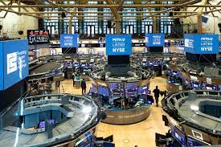
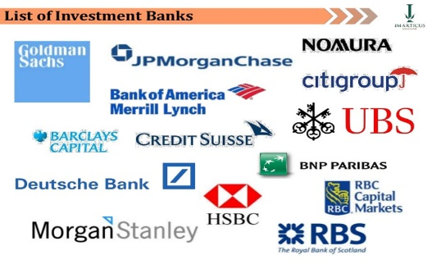


Loanable Funds Market
The market where savers supply funds for loans to borrowers.
Includes such places as:

Slide 5
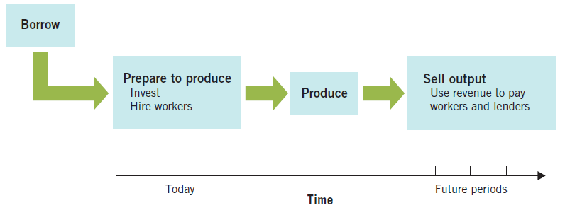
Why do firms need to borrow?
Firms borrow to

Slide 6

Savings, Investment & Financial Markets
Every dollar borrowed requires a dollar saved.
Lenders can’t lend money they don’t have.
Savings provides funds for lenders to lend.
Savings
Borrowing
Investment
GDP

Slide 7
Interest Rates
Interest rates: price of loanable funds, quoted as a percentage of the original loan amount.
Determined by market supply and demand.
Can be viewed as:
the reward for saving.
the price of borrowing.

Slide 8
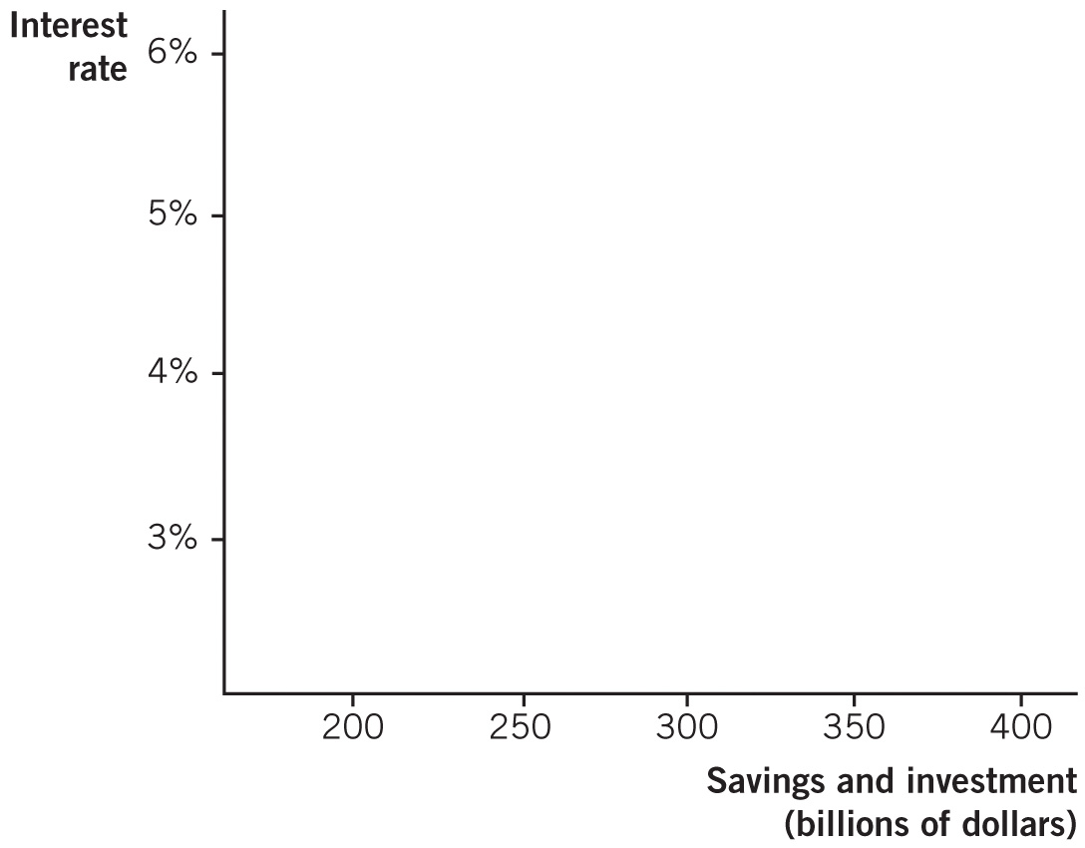
The Loanable Funds Market

Slide 9
Interest Rates
Supply Side
Demand Side
Higher interest rates yield greater future returns.
This table represents the future value of $500 in savings at different interest rates.
Profit-maximizing firms borrow to fund an investment only if the expected return on the investment is greater than the interest rate on the loan.
Should a firm borrow $ at 4% for an investment expecting a return of $ ?
Interest Rate | Value after 1 Year
4% | 520
5% | 525
6% | 530
10% | 550

Slide 10
Real and Nominal Interest Rates
Real interest rate: The interest rate corrected for inflation.
Nominal interest rate: The interest rate before it is corrected for inflation.
Fisher equation: real interest rate (r) = nominal interest rate (i) – inflation rate (π).
Can also be expressed as: nominal interest rate (i) = real interest rate (r) + inflation rate (π).

Slide 11
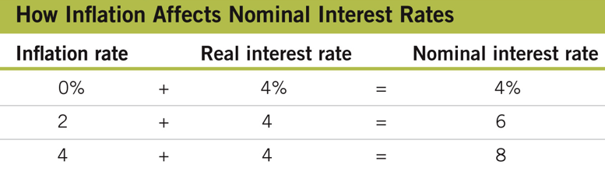
Fisher Effect
For a given real interest rate, the higher the rate of inflation, the higher the nominal rate.

Slide 12
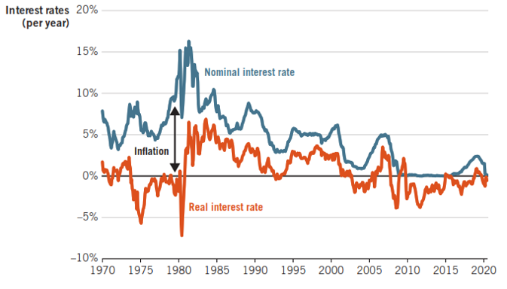
Real and Nominal IR, 1970-2020
Would you prefer a 5 % real interest rate or a -1 % real interest rate?
Depends on whether you are a borrower or a saver

Slide 13

Winners & Losers of Inflation

Slide 14
Supply Curve of Loanable Funds
Movement along the supply curve for loanable funds is caused by a change in the interest rate.
Shift in the supply of loanable funds is caused by:
Changes in income and wealth
Changes in time preferences
Consumption smoothing

Slide 15
Changes in Income and Wealth
Increases in either income or wealth generally produce increases in savings.
As the world gets richer, funds make their way into the U.S. loanable funds market, making borrowing easier for U.S. firms.

Slide 16
Time Preferences
Time preferences: The fact that people prefer to receive goods and services sooner rather than later.
Two general rules of preferences:
1. People prefer more to less
2. People prefer now to later
If you make someone wait until later, you must compensate by giving them more!

Slide 17
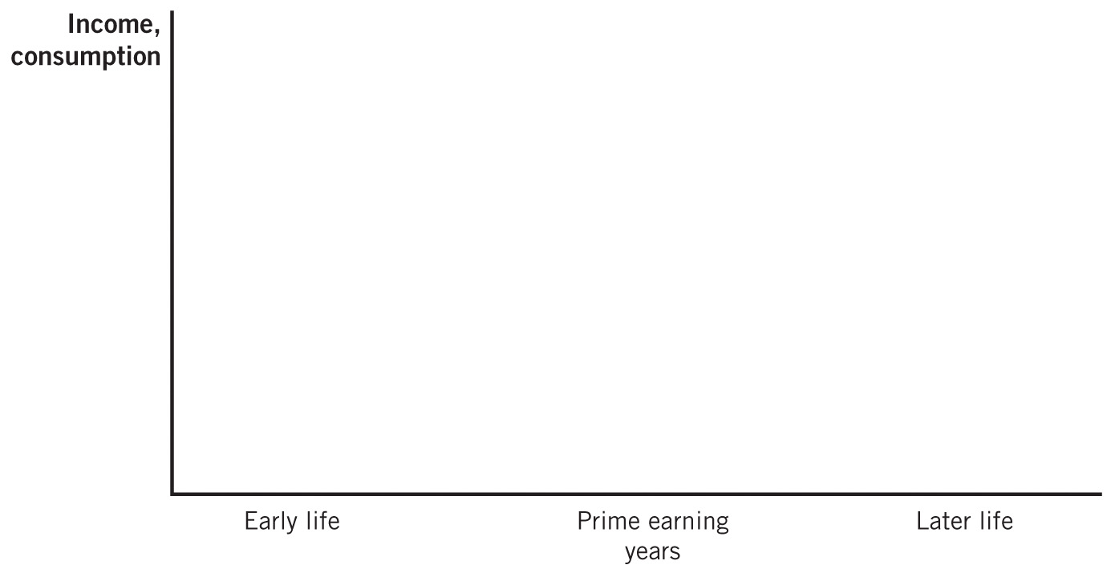
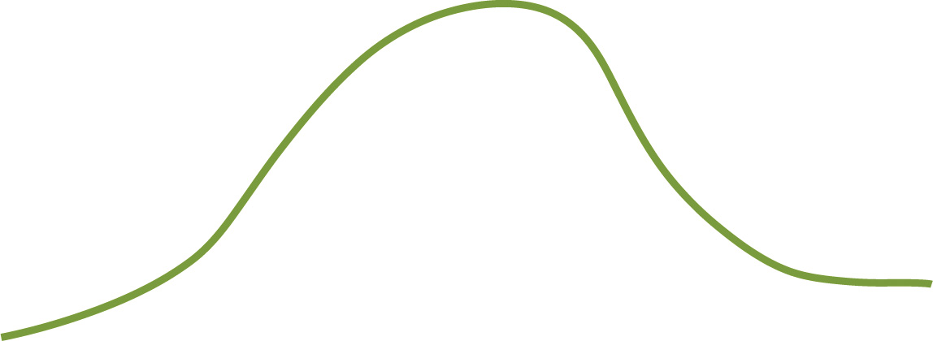




Consumption Smoothing

Slide 18
Shifts in the Supply of Loanable Funds

Slide 19
Factors That Impact the Supply of Savings
Factor | Direction of Effect | Explanation
Income and wealth | Positive relationship + | Savings is more affordable when people have higher income and wealth.
Time preferences | Negative relationship ̶ | Decreased time preferences indicate that people are more patient and more likely to save for the future.
Consumption smoothing (midlife) | Positive relationship + | Income varies over the lifecycle, but people generally like to smooth consumption.

Slide 20

1843: Charles Dickens, A Christmas Carol
Ebenezer Scrooge:
Accidental Promoter of Economic Growth?
Who was better for economic growth, Scrooge the saver or Scrooge the spender?

Slide 21
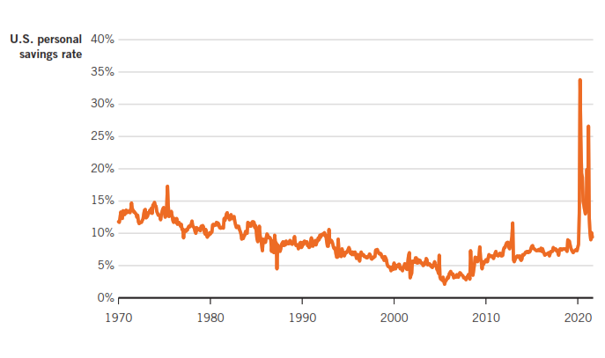
Savings Rate in the U.S., 1970–2021
Savings rate fell for three straight decades
Huge spike during COVID-19.

Slide 22
Demand for Loanable Funds
Demanders of loanable funds are borrowers.
Demand is driven largely by firms that need to borrow for large capital projects.
Governments also borrow
Recall:
Borrowing must occur to build capital goods.
This occurs before any production of final goods.

Slide 23
Demand Curve for Loanable Funds
Movement along the demand curve for loanable funds is caused by a change in the interest rates
Shift in the demand of loanable funds caused by
Changes in the productivity of capital
Changes in investor confidence
Government borrowing

Slide 24



Shifts in the Demand for Capital
Productivity of capital
If capital becomes more productive, demand for loans will rise
Returns on investment (at any interest rate) will be greater
Example: Internet & computers
Investor confidence
If a firm is optimistic, it will borrow more today
Changes in capital productivity & investor confidence will shift the demand for loanable funds

Slide 25
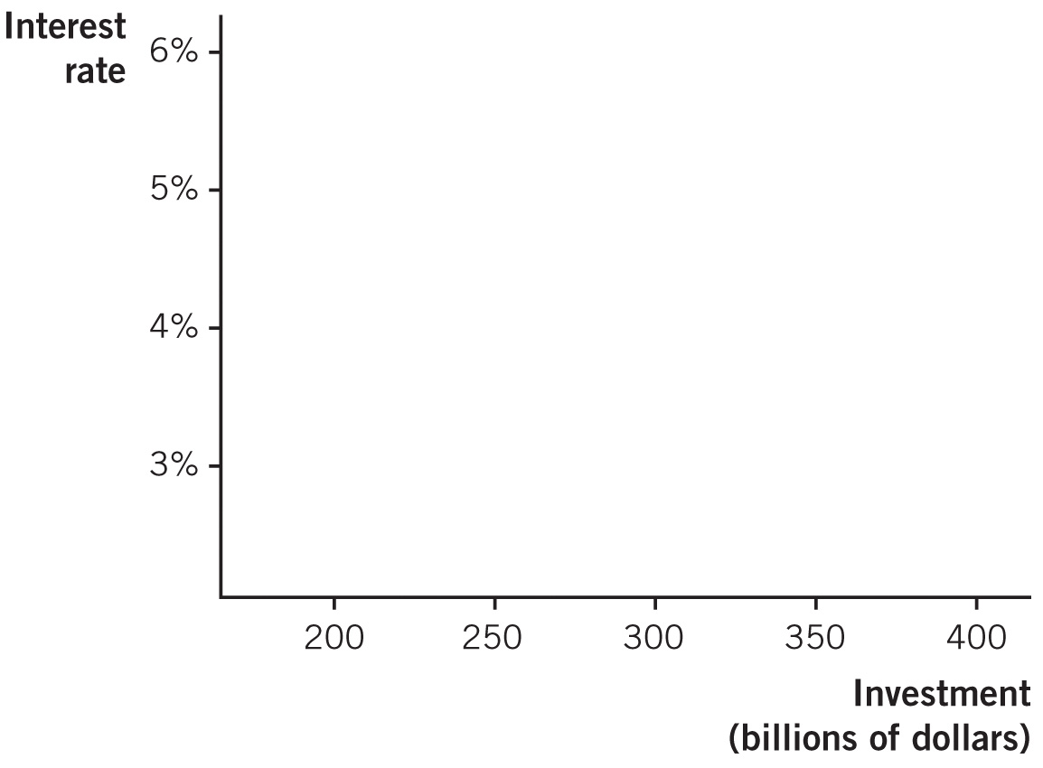
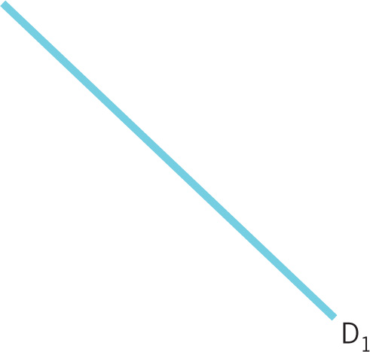
Shifts in the Demand for Loanable Funds

Slide 26
Equilibrium in Loanable Funds Market
In equilibrium:
savings = investment.
Supply of loanable funds is savings
Demand for loanable funds is firms wanting to borrow
Relationship between saving & borrowing:
Every dollar borrowed requires a dollar saved.

Slide 27
Equilibrium in Loanable Funds Market
The price that clears this market is the interest rate

Slide 28
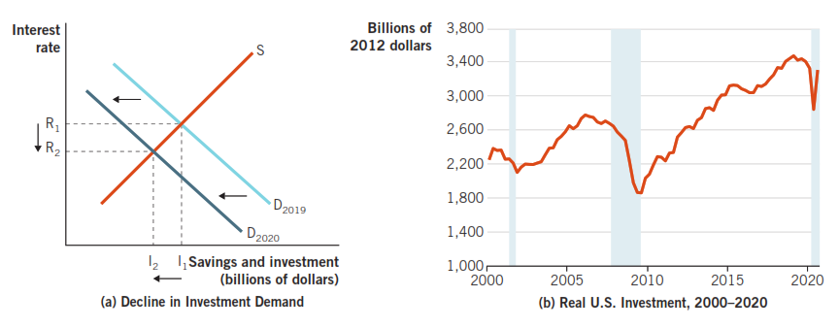
Decline in Investor Confidence (2008 & 2020)

Slide 29
Future of the Loanable Funds Market in the U.S.
Two important factors will shape the loanable funds market in the future:
1. Fall in the savings rate over past 30 years
Increase in time preferences would cause a leftward supply shift.
Increase in foreign savings in the United States could shift supply back to the right.
2. Retirement of baby boomers: dissaving would cause a leftward shift in the supply of funds.

Slide 30
